Slide 1
Area of a triangle
Perimeter and area

Slide 2
how to use Oak lessons

Slide 3
I can derive the formula for the area of a triangle.

Slide 4
The base is the side which is perpendicular to the height.
The perpendicular height is the perpendicular distance from the base to the opposite vertex.

Slide 5

Area of a triangle
Reviewing the area and perimeter of a triangle
Deriving the formula for the area of a triangle

Slide 6
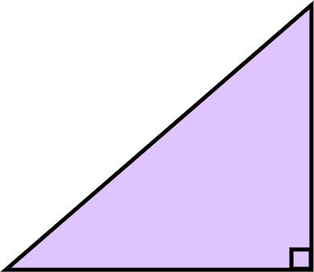

Reviewing the area and perimeter of a triangle
The area of a triangle can be found by multiplying the base and perpendicular height of the triangle, and then dividing by two.
Area
units²
3 units
4 units

Slide 7
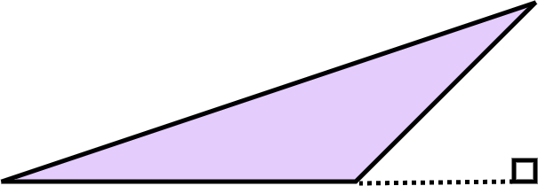

Reviewing the area and perimeter of a triangle
It is sometimes easier to show the perpendicular height outside of the triangle.
Area
units²
5 units
7 units

Slide 8
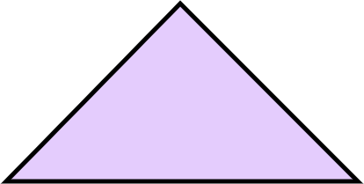
Reviewing the area and perimeter of a triangle
Do these two triangles have the same area? Explain your reasoning.
5 units
5 units
7 units
7 units
They do have the same area as they have the same base and same height as each other.

Slide 9
Reviewing the area and perimeter of a triangle
Do these two triangles have the same area? Explain your reasoning.

Slide 10
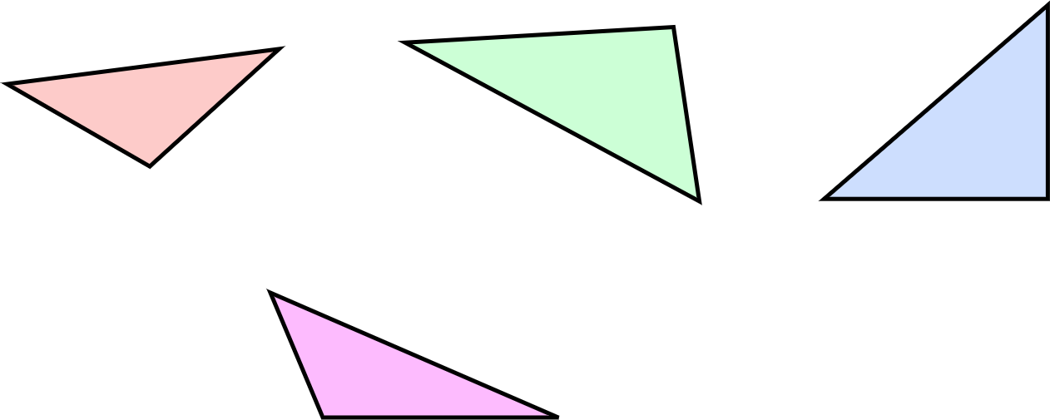
Reviewing the area and perimeter of a triangle
1)
a) b) c)
4 cm
5 cm
5 cm
2 cm
3 cm
4 cm
5 cm
2.5 cm
4 cm
d)
4 cm
3 cm
For each triangle, do you have enough information to calculate the area, the perimeter, both or neither? Explain how you know.

Slide 11
Reviewing the area and perimeter of a triangle
2)
a) b) c)
4 cm
5 cm
5 cm
2 cm
3 cm
4 cm
5 cm
2.5 cm
4 cm
d)
4 cm
3 cm
For the ones that are not possible, write the minimum additional information you need.

Slide 12
Reviewing the area and perimeter of a triangle
1)
a) b) c)
4 cm
5 cm
5 cm
2 cm
3 cm
4 cm
5 cm
2.5 cm
4 cm
d)
4 cm
3 cm
For each triangle, do you have enough information to calculate the area, the perimeter, both or neither? Explain how you know.

Slide 13
Reviewing the area and perimeter of a triangle
2)
a) b) c)
4 cm
5 cm
5 cm
2 cm
3 cm
4 cm
5 cm
2.5 cm
4 cm
d)
4 cm
3 cm
For the ones that are not possible, write the minimum additional information you need.

Slide 14
Reviewing the area and perimeter of a triangle
a) b) c)
4 cm
5 cm
5 cm
2 cm
3 cm
4 cm
5 cm
2.5 cm
4 cm
d)
4 cm
3 cm
Triangle A: I can calculate the area but not the perimeter. For the perimeter, I need the remaining side length.

Slide 15
Reviewing the area and perimeter of a triangle
a) b) c)
4 cm
5 cm
5 cm
2 cm
3 cm
4 cm
5 cm
2.5 cm
4 cm
d)
4 cm
3 cm
Triangle B: I can calculate the perimeter but not the area. For the area, I need the length of a perpendicular line from one side to the opposite vertex.

Slide 16
Reviewing the area and perimeter of a triangle
a) b) c)
4 cm
5 cm
5 cm
2 cm
3 cm
4 cm
5 cm
2.5 cm
4 cm
d)
4 cm
3 cm
Triangle C: I can calculate both the perimeter and area.

Slide 17
Reviewing the area and perimeter of a triangle
a) b) c)
4 cm
5 cm
5 cm
2 cm
3 cm
4 cm
5 cm
2.5 cm
4 cm
d)
4 cm
3 cm
Triangle D: I can calculate neither the perimeter nor the area. I need the length of the two remaining sides.

Slide 18
Area of a triangle
Reviewing the area and perimeter of a triangle
Deriving the formula for the area of a triangle

Slide 19
Deriving the formula for the area of a triangle
The formula for the area of a triangle can be derived through an investigation.

Slide 20

Deriving the formula for the area of a triangle
1) Instructions:
Take a piece of paper and fold it in half.

Slide 21

Deriving the formula for the area of a triangle
1) Instructions:
Draw a triangle on your piece of folded paper (try to make it different from mine).

Slide 22

Deriving the formula for the area of a triangle
1) Instructions:
Cut out your triangle. You should have two identical triangles due to your folded paper.

Slide 23
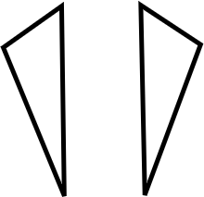
Deriving the formula for the area of a triangle
1) Instructions:
Put your two triangles next to each other. You can flip and/or rotate either of them.
Which quadrilaterals can you make?

Slide 24






Deriving the formula for the area of a triangle
1) Depending on the triangle drawn, the following quadrilaterals are possible:
Kite
Parallelogram
Rectangle
Square
Rhombus
Arrowhead

Slide 25
Deriving the formula for the area of a triangle
2) Take your two triangles. Can you make each of the 6 quadrilaterals shown below?
List the quadrilaterals you can make.
Which quadrilateral can always be made?

Slide 26
Deriving the formula for the area of a triangle
Regardless of the triangle drawn, a parallelogram can always be made.
Rectangles and rhombuses are special types of parallelograms. Squares are special types of rhombuses.

Slide 27
Deriving the formula for the area of a triangle
The area of a triangle is half the area of a parallelogram.
This is because two identical triangles can always be placed together to create a parallelogram.

Slide 28
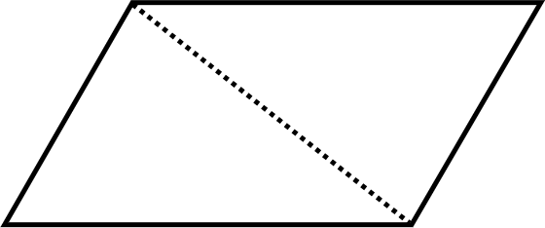
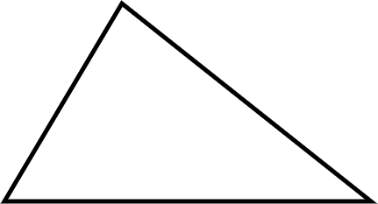

Deriving the formula for the area of a triangle
Area = base × perpendicular height
= bh
Area = ½ × base × perpendicular height
=

Slide 29

Deriving the formula for the area of a triangle
The area of a triangle is always half the area of a rhombus.
Any two identical triangles make a parallelogram.

Slide 30
Area of a triangle
The area of any triangle is half the area of the parallelogram made from two copies of that same triangle.

Slide 31

© Oak National Academy 2024.
Produced in partnership with Mathematics in Education and Industry.
Licensed on the Open Government Licence v3.0, except where otherwise stated. See Oak terms and conditions.

